Slide 1
British Airways
Predictive model and its results
08-08-2024

Slide 2
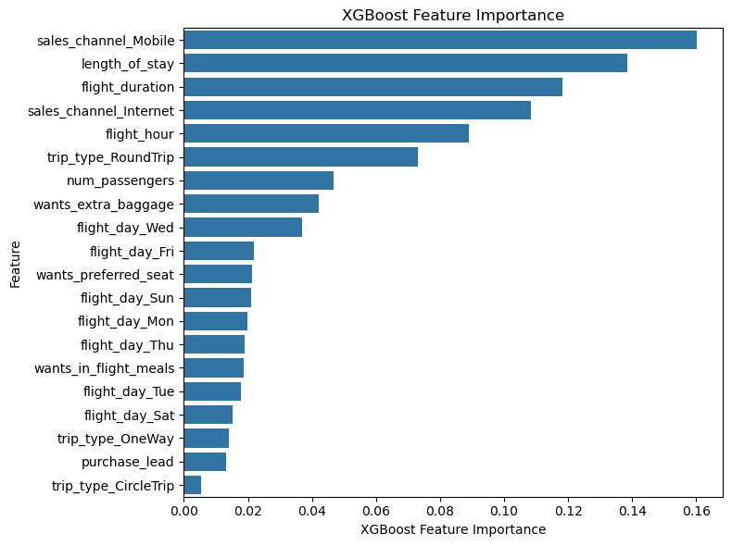
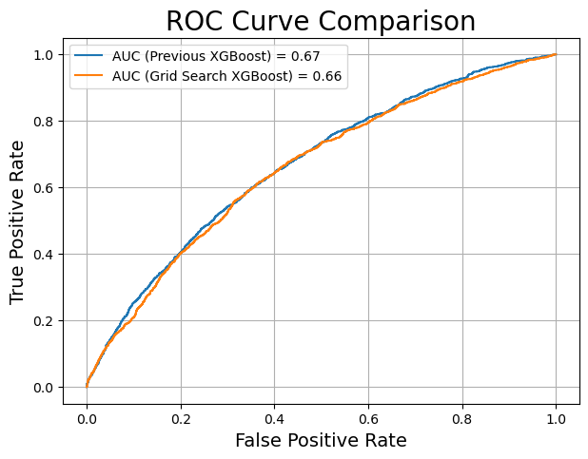
Predictive modelling
Performance metrics for completed bookings
We have trained 2 models:
RandomForest Classifier
XgBoost Classifier
Best Model:
XGBoost
F1 Score
91%
Accuracy
85%
Precision
86%
Recall
98%
We balanced our dataset using oversampling and under-sampling techniques (SMOTE-RUS) because the initial class distribution was unbalanced (Label 0: 41890 | Label 1: 7391)
To evaluate model performance, we focused on F1-Score rather than just accuracy
SUMMARY:
Strong prediction for Completed Bookings, but room for improvement with Uncompleted Bookings
Top features that can drive successful flight bookings

